Slide 1

Kenny Song, NYU Abu Dhabi
Nael hailemariam, Beihang university
Game of code 2016

Slide 2
Problem
1. You want to know where you can park your car tomorrow, using historical parking lot data for certain areas and times.
2. You want to know the closest available parking lot right now.

Slide 3
Solution
ParkLux is a web application that tracks the status of the City of Luxembourg’s parking lots over time.
It can tell you the closest available spot to park your car right now, as well as the # of open spots in every parking lot in the city.
It can also tell you the best time and place to park your car by looking at historical data.

Slide 4
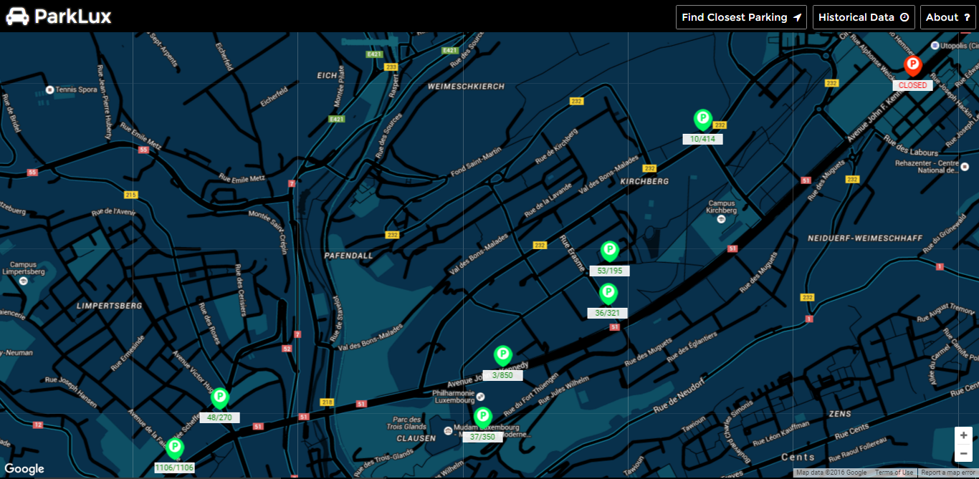
Data taken at 4:01 PM, 09/APRIL/2014

Slide 5
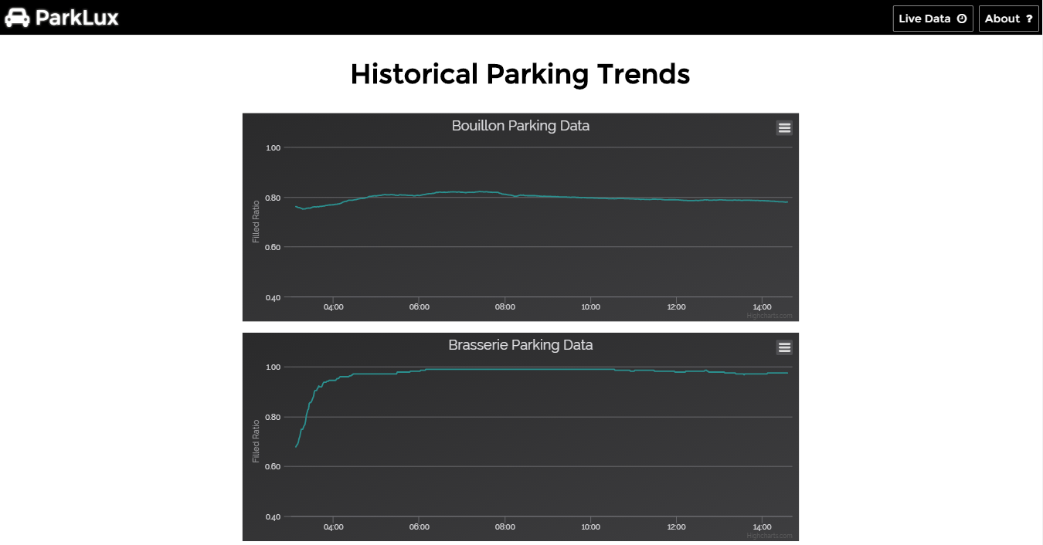
Data taken at 4:05 PM, 09/APRIL/2014

Slide 6
Technical Overview
Python Flask server running on Microsoft Azure
Data is stored and streamed in real-time with Firebase
Google Maps API provides core front-end functionality

Slide 7
Live Demo
https://parklux.azurewebsites.net/

Slide 8

Any Q?

